Slide 1

Financial Aid at IUPUC Kristina Delbridge, Assistant Director of Financial Aid and Scholarships
IUPUC Office of Student Financial Services

Slide 2
Financial Aid
For Federal and State (Indiana) Aid:
Complete the FAFSA listing school code E01033
State Deadline April 15
CVO application if applicable
College Goal Sunday Events:
Visit collegegoalsunday.org for all locations.
November 6, 2022; 2-4 pm
February 26, 2023; 2-4 pm
https://studentaid.gov/h/apply-for-aid/fafsa
https://www.in.gov/che/state-financial-aid/state-financial-aid-by-program/

Slide 3
2023-2024 FAFSA updates
Removal of questions related to Selective Service registration.
Removal of the drug conviction questions and corresponding eligibility worksheet.
Addition of a demographic survey with questions related to gender, ethnicity, and race.
Students who were initially determined to be dependent and used the IRS DRT, or whose parent used the IRS DRT, had been unable to submit a correction in which their dependency status was now “independent.” This issue has now been resolved and users should no longer encounter this problem.

Slide 4
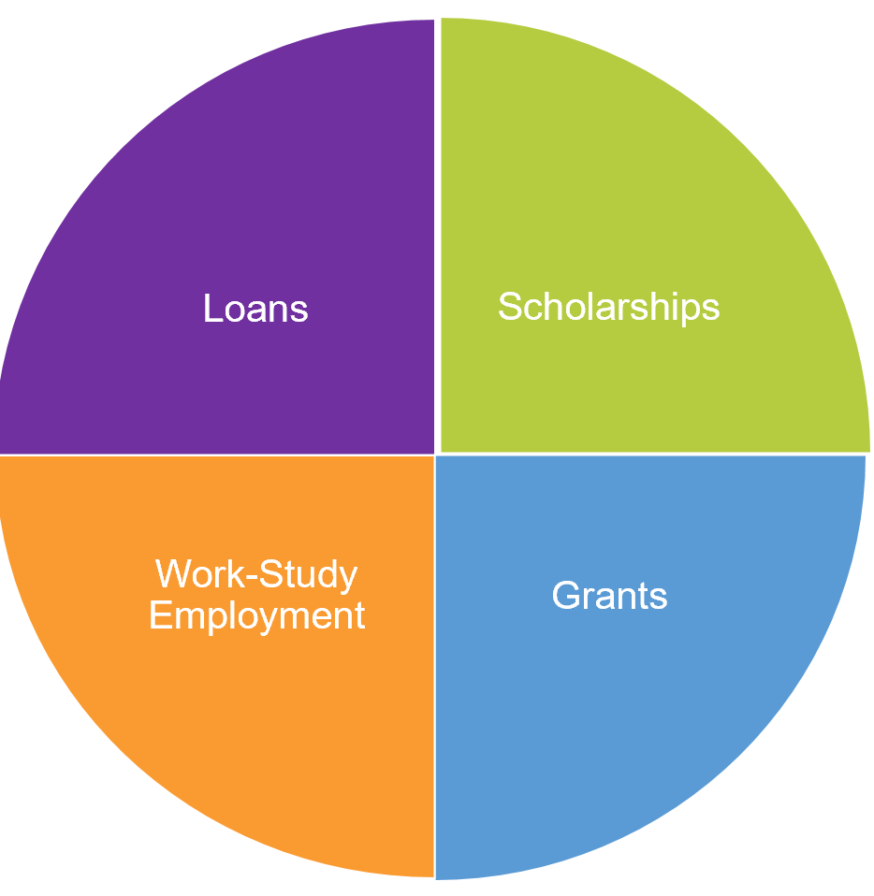
Types of Financial Aid
Scholarships- Free money from your college or external sources.
Grants- Free Federal and State funding, which include 21st Century Scholars and Pell grants.
Loans- Loans for student and parents that need to be repaid.
Work-Study Employment- Earn money while working on campus.

Slide 5
State Updates
OLD NEWS: 21st Century: College Scholar Success Program requirements are GONE. This had activities the students had to log while in college to keep the 21st Century Scholarship.
NEW NEWS: Frank O’Bannon will increase for 2023-2024
35% increase to the maximum Frank O’Bannon Grant base-award amounts
This brings the maximum award back to pre-recession levels when adjusted for inflation.
Maximum award at public institution is will be $ 6,200.

Slide 6
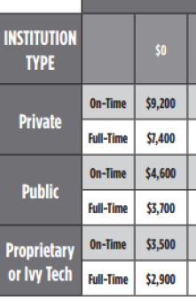
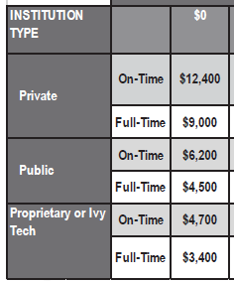
OLD VS. NEW

Slide 7
Dependency Overrides
Students who are unable to provide parent information on their FAFSA due to unusual situations.
Incarcerated parents, no relationship with parents due to abuse, neglect, or abandonment.
Colleges have a process to override the FAFSA to make the student independent.
This process doesn’t consider parents who don’t want to or are unable to provide financial support. Students will need to provide parent information.

Slide 8
Appeals
All FAFSA Income Data is based on information from 2 years prior. 2023-2024 FAFSA is based on data from 2021.
If situation has changed since filing the FAFSA
If the income information on the FAFSA is outdated
If there are extenuating circumstances that were not addressed on the FAFSA
If there are expenses that you would like appropriated into your cost of attendance (such as medical/dental expenses)

Slide 9

Scholarships
For Scholarships:
Admission-Based Scholarships are based on application
Athletic Scholarships! (started 22-23)
Institutional Scholarships
Annual completion of the General Application or other application in the Scholarships tile
Additional information/essay as required
Outside Scholarships may be found online or in your community
https://students.iupuc.edu/paying-for-college/scholarships/index.html
Notes:
For Students: New Students who have applied for admission prior to February 15 will automatically be considered for the Admission based scholarship at IUPUC. We now offer Athletic Scholarships to IUPUC students – baseball, cross country, soccer, tennis, and softball. Also, All students should apply for other institutional scholarships by completing the General Application in the Scholarships tile within one.iu.edu. This opens on September 1 for the subsequent school year and we recommend that you to register early since some scholarships close earlier than others. For private scholarships, we recommend that you use a trusted source and for your convenience we list several safe sites on our website. We encourage you to also see if scholarships are available through your employer, places you have volunteered, community foundations, and high school alumni associations as well.

Slide 10
Why IUPUC?
What a great education for a low cost!
In-state Banded Tuition
2022-2023 Tuition and Fees: $9,790 Undergraduate Resident Student Enrolled Full-time for fall/spring
Estimate costs using the cost calculator: https://moneysmarts.iu.edu/

Slide 11
Thank you!
Email us at financialaid@iupuc.edu
Request a Virtual Appointment at financialaid@iupuc.edu
Call us at 844-448-9281
Visit our office
Resources: Financial Aid toolkit for handouts helpful
for students and parents:
https://financialaidtoolkit.ed.gov/tk/resources.jsp

