Slide 1

IUPUC Honors Program
INDIANA UNIVERSITY–PURDUE UNIVERSITY COLUMBUS

Slide 2


Your Honors Support Team
Program Director:
Dr. Stephanie Serriere
scayot@iu.edu
812.348.7245
Office: CC 155G
Honors Advisor:
Bree Hobbs
brehobbs@iu.edu
812.348.7274
Office: 156E

Slide 3

Who is invited to join?
Incoming freshmen:
High school GPA of 3.75 or better
Current IUPUC students:
IUPUC GPA of 3.5 or better after 12 credits or more
Image from IUPUC 2018-19 Annual Report

Slide 4
Top 5 reasons to be an Honors Scholar
IUPUC Honors
1. $1,000 Scholarship
Per year (limited to 20 most qualified)
2. Work closely with faculty on projects
3. RECEIVE SPECIAL RECOGNITION AT GRADUATION, ON YOUR DIPLOMA, AND RESUME
4. Present your work at conference, workshops, and events
5. PARTICIPATE IN ACTIVITIES WITH FELLOW HONORS STUDENTS IN AND OUT OF THE CLASSROOM

Slide 5

Finances
$1,000/year of $5,962 annual tuition = ~17% of your annual tuition covered
~14 scholarships to be awarded this summer for next year.
$500/semester
Must be enrolled in 12 or more credit hours
Summers are not funded.
Studentdebtrelief.us

Slide 6
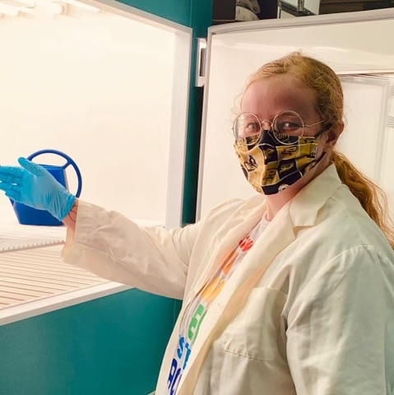

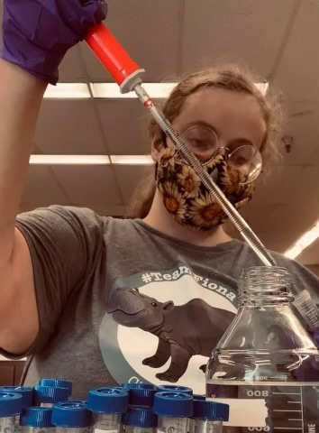
#2. Work closely with faculty on projects

Slide 7

#3. Receive special recognition at graduation, on your diploma, and on your resume
IUPUC Honors
IUPUC Medallion Ceremony ​
immediately preceding IUPUC Graduation​
​

Slide 8

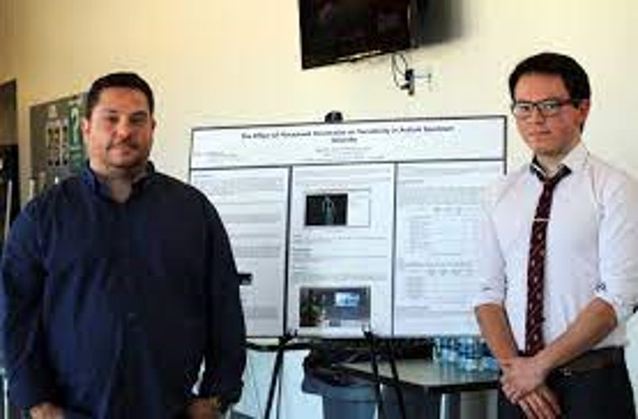
#4. Present your work at conference, workshops, and events
IUPUC Honors
A perfect opportunity to present at the ​
Office of Student Research (OSR) exhibition! ​

Slide 9


#5- Participate in activities with fellow honors student in and out of the classroom
IUPUC Honors

Slide 10
How does this change my course of study?
Required 24 honors credits before graduation integrated into your existing plan of study.
Approximately class per/semester, students choose to “honors option” a course of interest.
Working with an instructor, students complete an extension project of course material.
  This may involve field or lab research, a community engaged project, or another in-depth exploration determined together by student and instructor!

Slide 11
Honors Program Requirements:
  Complete 24 credit hours of honors work
    3 credits/semester x 8 semesters
  Maintain an overall and Honors Program 3.3 or higher cumulative GPA.
  Complete at least 3 hours of honors credits each semester.
Notes:
Bree

Slide 12
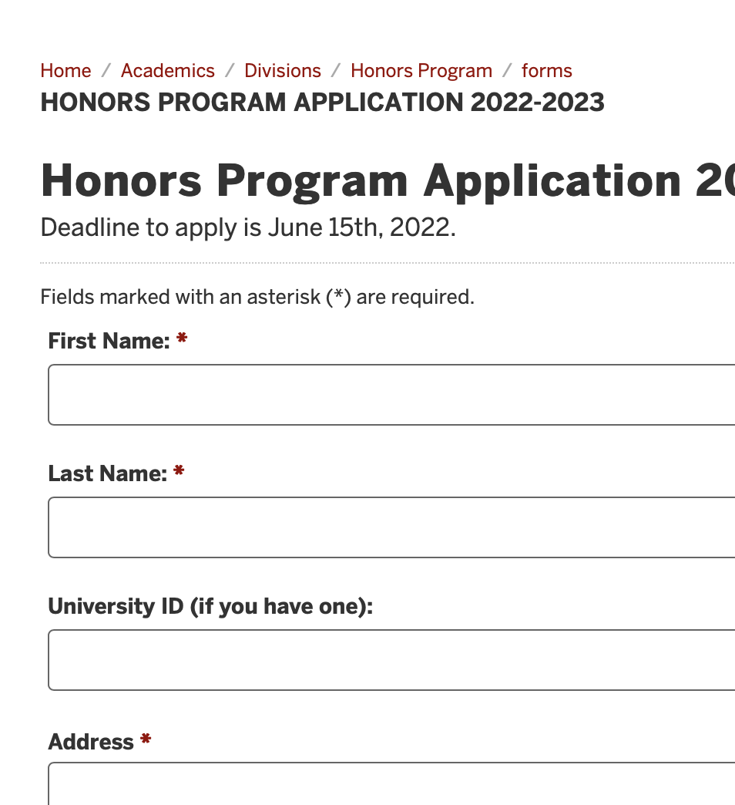
How and when to Apply?
Complete the easy application form by June 15th available at:
https://iupuc.edu/honors/admission
Students are notified in July if they are a scholarship recipient.

Slide 13

Enrich your college experience
- be an Honors Scholar!
Image from IUPUC 2018-19 Annual Report

